Slide 1
Research data systems
Kihuha, Norbert and Mshote, Lucian
KEMRI-Wellcome Trust

Slide 2
Research data management
careful handling and organization of research data throughout the entire research lifecycle with the aim to carry out research activities efficiently and allow collaboration with others. specifically:
to protect research data against loss;
to enable sharing of research data with others (FAIR)
to make research data discoverable, accessible and (re)usable
Notes:
Data Safety - this is to protect against data loss through storage (including backups) and archiving, and by good organization and documentation;
Data security - this is protection of data against unwanted changes, which can be achieved by controlling access to data;
data organization, protecting data from untraceability by systematic data arrangements
Findable: - Rich Meta Data
Accessible - (meta)data are retrievable by their identifier using a standardized communications protocol.

Slide 3
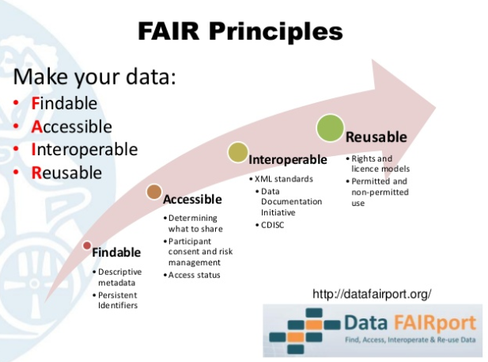
RDM- Sharing research data
Notes:
Replication and reproducibility
if these can be reused quickly and easily. A number of simple measures will help improve usability of your data. These are:
make sure your data are ‘tidy’ – can be easily altered and processed
document your data
use open data formats as much as possible

Slide 4
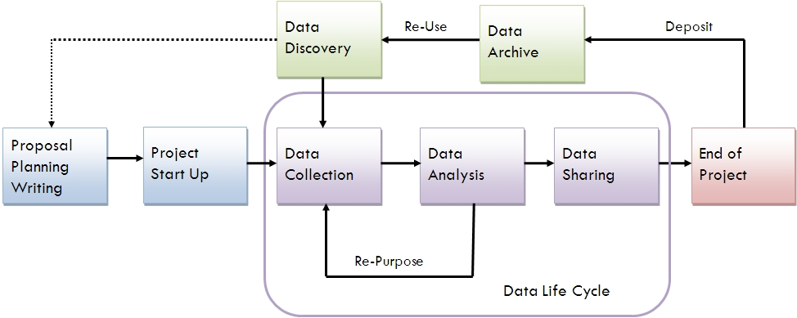
Research data life cycle
Harvard DataVerse
D Space
Protocol Tracking System (PTS)
KIDMS
REDCap
LIMS
KHDSS EDCS
OpenClinica
Stata, R, Python, endnote, Mendeley

Slide 5
DATA SYSTEMS AT KWTRP
Surveillance
Clinical trials
Laboratory
Research Studies
Research Support
Notes:
A data collection system (DCS) is a system that aggregates and evaluates sets of information in a consistent and efficient way. Modern data collection systems rely on advanced technology to take in huge amounts of data, and to parse it and analyze it correctly. This is part of what is behind the rush to "harness the power of big data" in today's sophisticated network systems.

Slide 6



Surveillance systems
These systems monitor long term surveillances
Hospital surveillance– Paediatrics , adult and maternity wards
KHDSS EDCS – HDSS data collection
HIV – key populations with high risks of HIV
Malaria Monitoring – Pingilikani, Ngerenya and Junju
Future Plans:
- Upgrade and extend KIDMS

Slide 7


CLINICAL TRIALS
Clinical trials are research studies performed in people that are aimed at evaluating a health(medical, surgical or behavioral) intervention
Methods and data is highly regulated
Systems should be:
Validated, verifiable with an audit trail
Allow for monitoring and versioning
Future Plans:
New system to replace OpenClinica
New system??

Slide 8
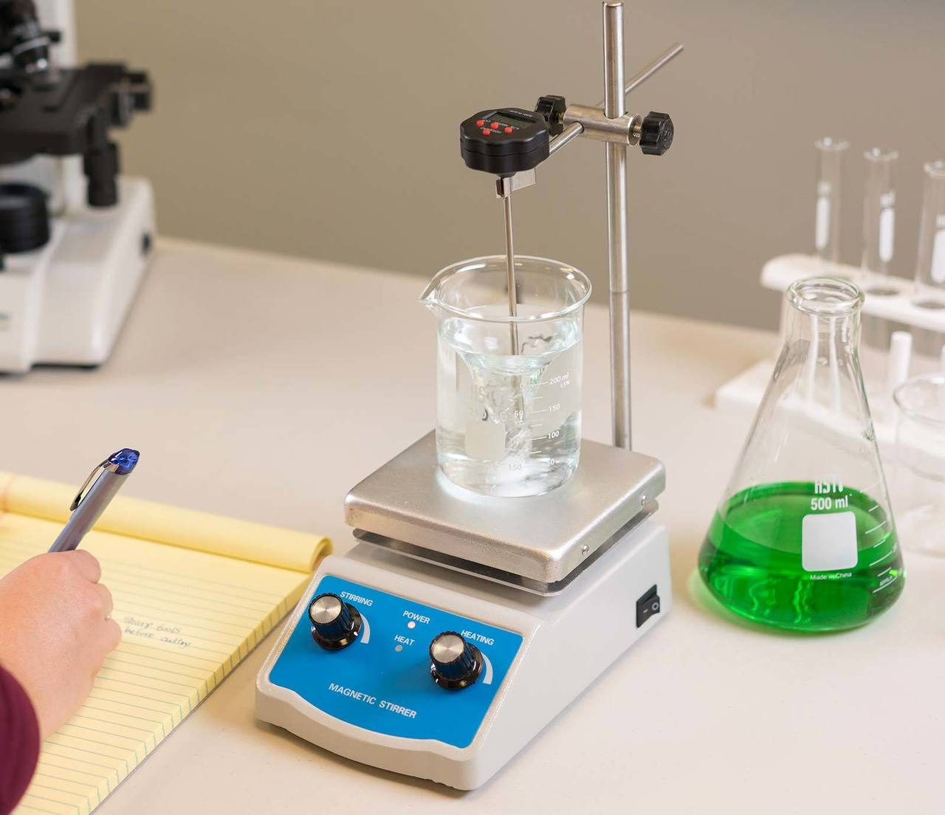
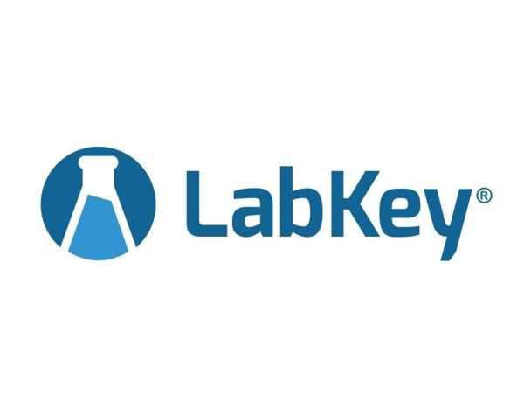
Laboratory
processing of samples collected by various studies
Form a major part of the clinical research process
KWTRP biobank has close to 2million samples
Support for storage, retrieval and shipment of samples
Future plans:
Barcoding
Equipment integration
LIMS

Slide 9
Research studies
Short and long term longitudinal and cross sectional studies
Custom applications are developed for specific studies
Requirement differ from study to study
Conducted in hospitals and at homestead
Future Plans:
Centralize most functionalities of these studies -
Use ODK for electronic data collection
Push most studies to REDCap
Vaccines Monitoring
Open Data Kit (ODK)*

Slide 10
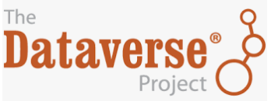
Research support
Applications for supporting the research governance office
Assist with regulatory processes during development and conduct of a study
Tracking of scientific ideas from concept to approval
Management of data requests for data sharing
Future plans:
Manuscripts and publications
CRIS
PTS
DGC App
Notes:
A current research information system (CRIS) is a database or other information system to store and manage data about research conducted at an institution

Slide 11






Kilifi Integrated Data Management System
KDHSS EDCS
Research Studies
Laboratories
PID
HDSS
Clinical

Slide 12









PostgreSQL

Slide 13
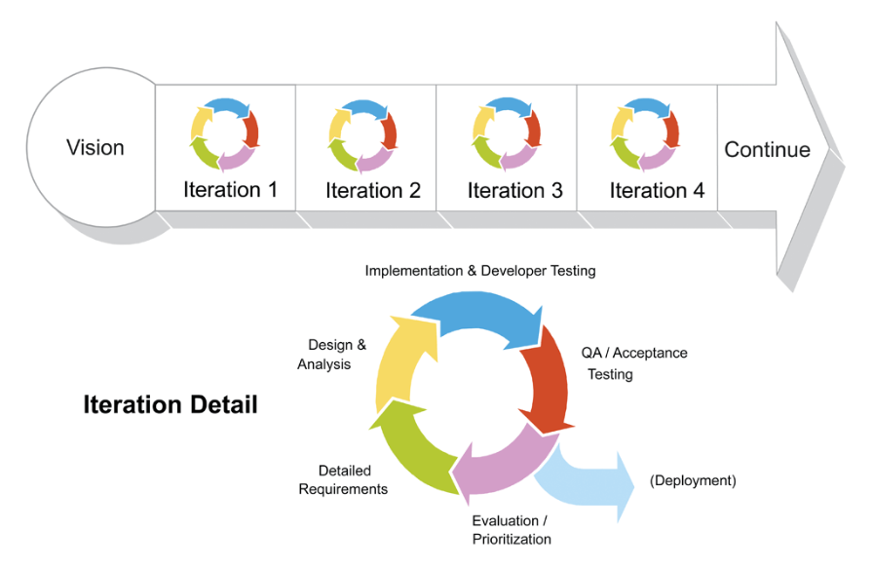
How we do it

Slide 14
Future plans
High availability – Apps and DB
Consolidation – reducing the number of independent small applications
More involvement in the earlier stages of the research process
Self service features
Use of more modern UI frameworks in developing applications
More support of external sites
Improve on Agile/Scrum

Slide 15

Questions?null:Tea

